Slide 1
ITMD455 Final Project
Dennis Chase
Devonald Manney
Raiven Johnson

Slide 2
The Challenge
Build a student behavior tracking system
There are plenty of classroom management apps and tools already available. We challenged ourselves to create an app to provide teachers with an easy tool to track and monitor students behavior in general.

Slide 3
The Approach
Focus on building student behavior database
Typical list style viewing of active students in a class
Provides teachers quick and intuitive means of documenting incidents, good or bad
Relieves headaches for review periods by giving specific points of reference

Slide 4
Our Solution
Specific student selection
Updating and addition of specific student behavior events, with date selection, viewable in a list format
Customizability for unincluded behaviors

Slide 5
How It Works

Slide 6
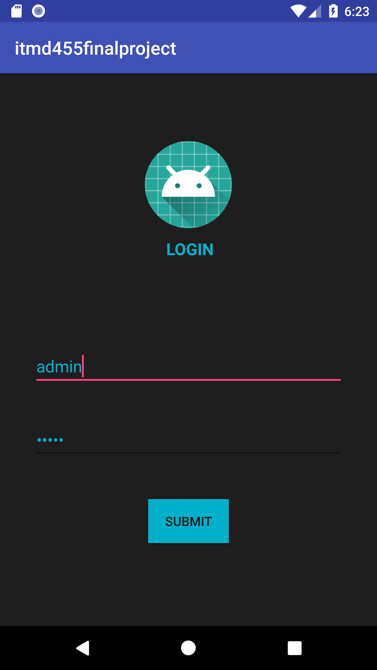
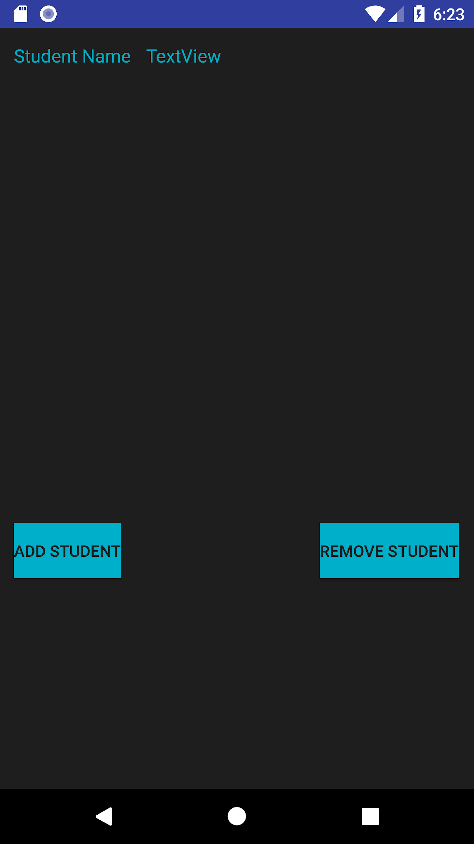
Login

Slide 7
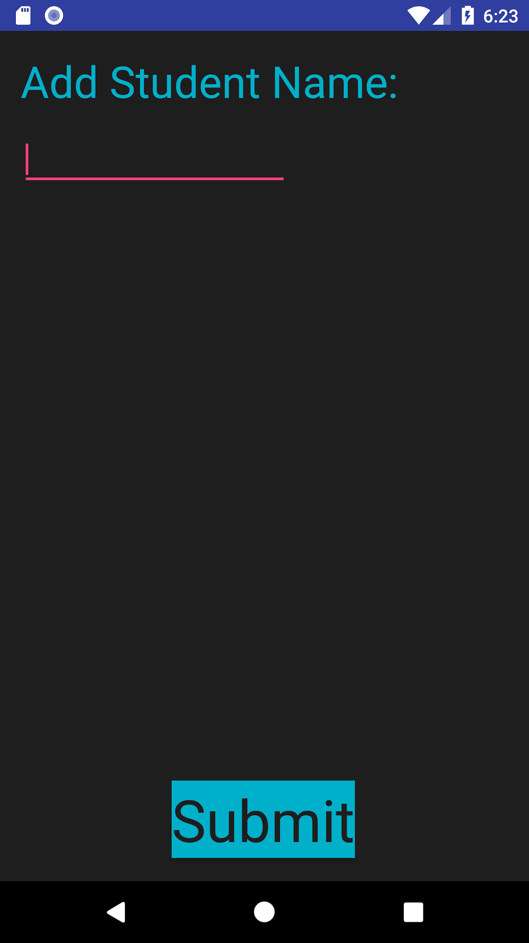
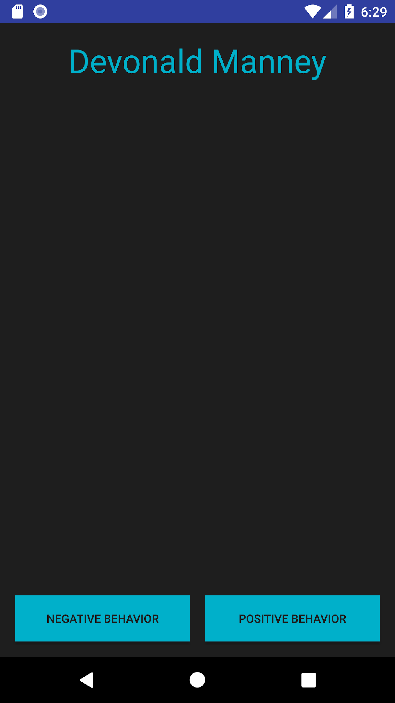
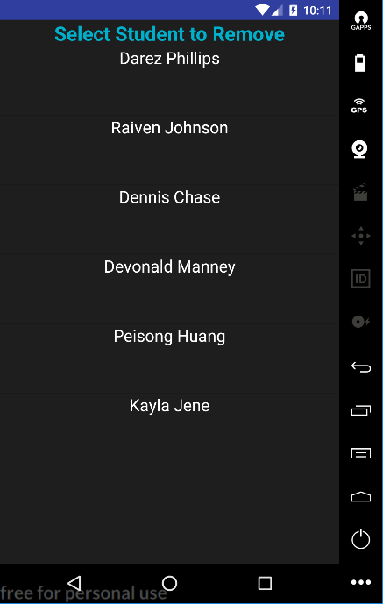
Add/Remove Student

Slide 8
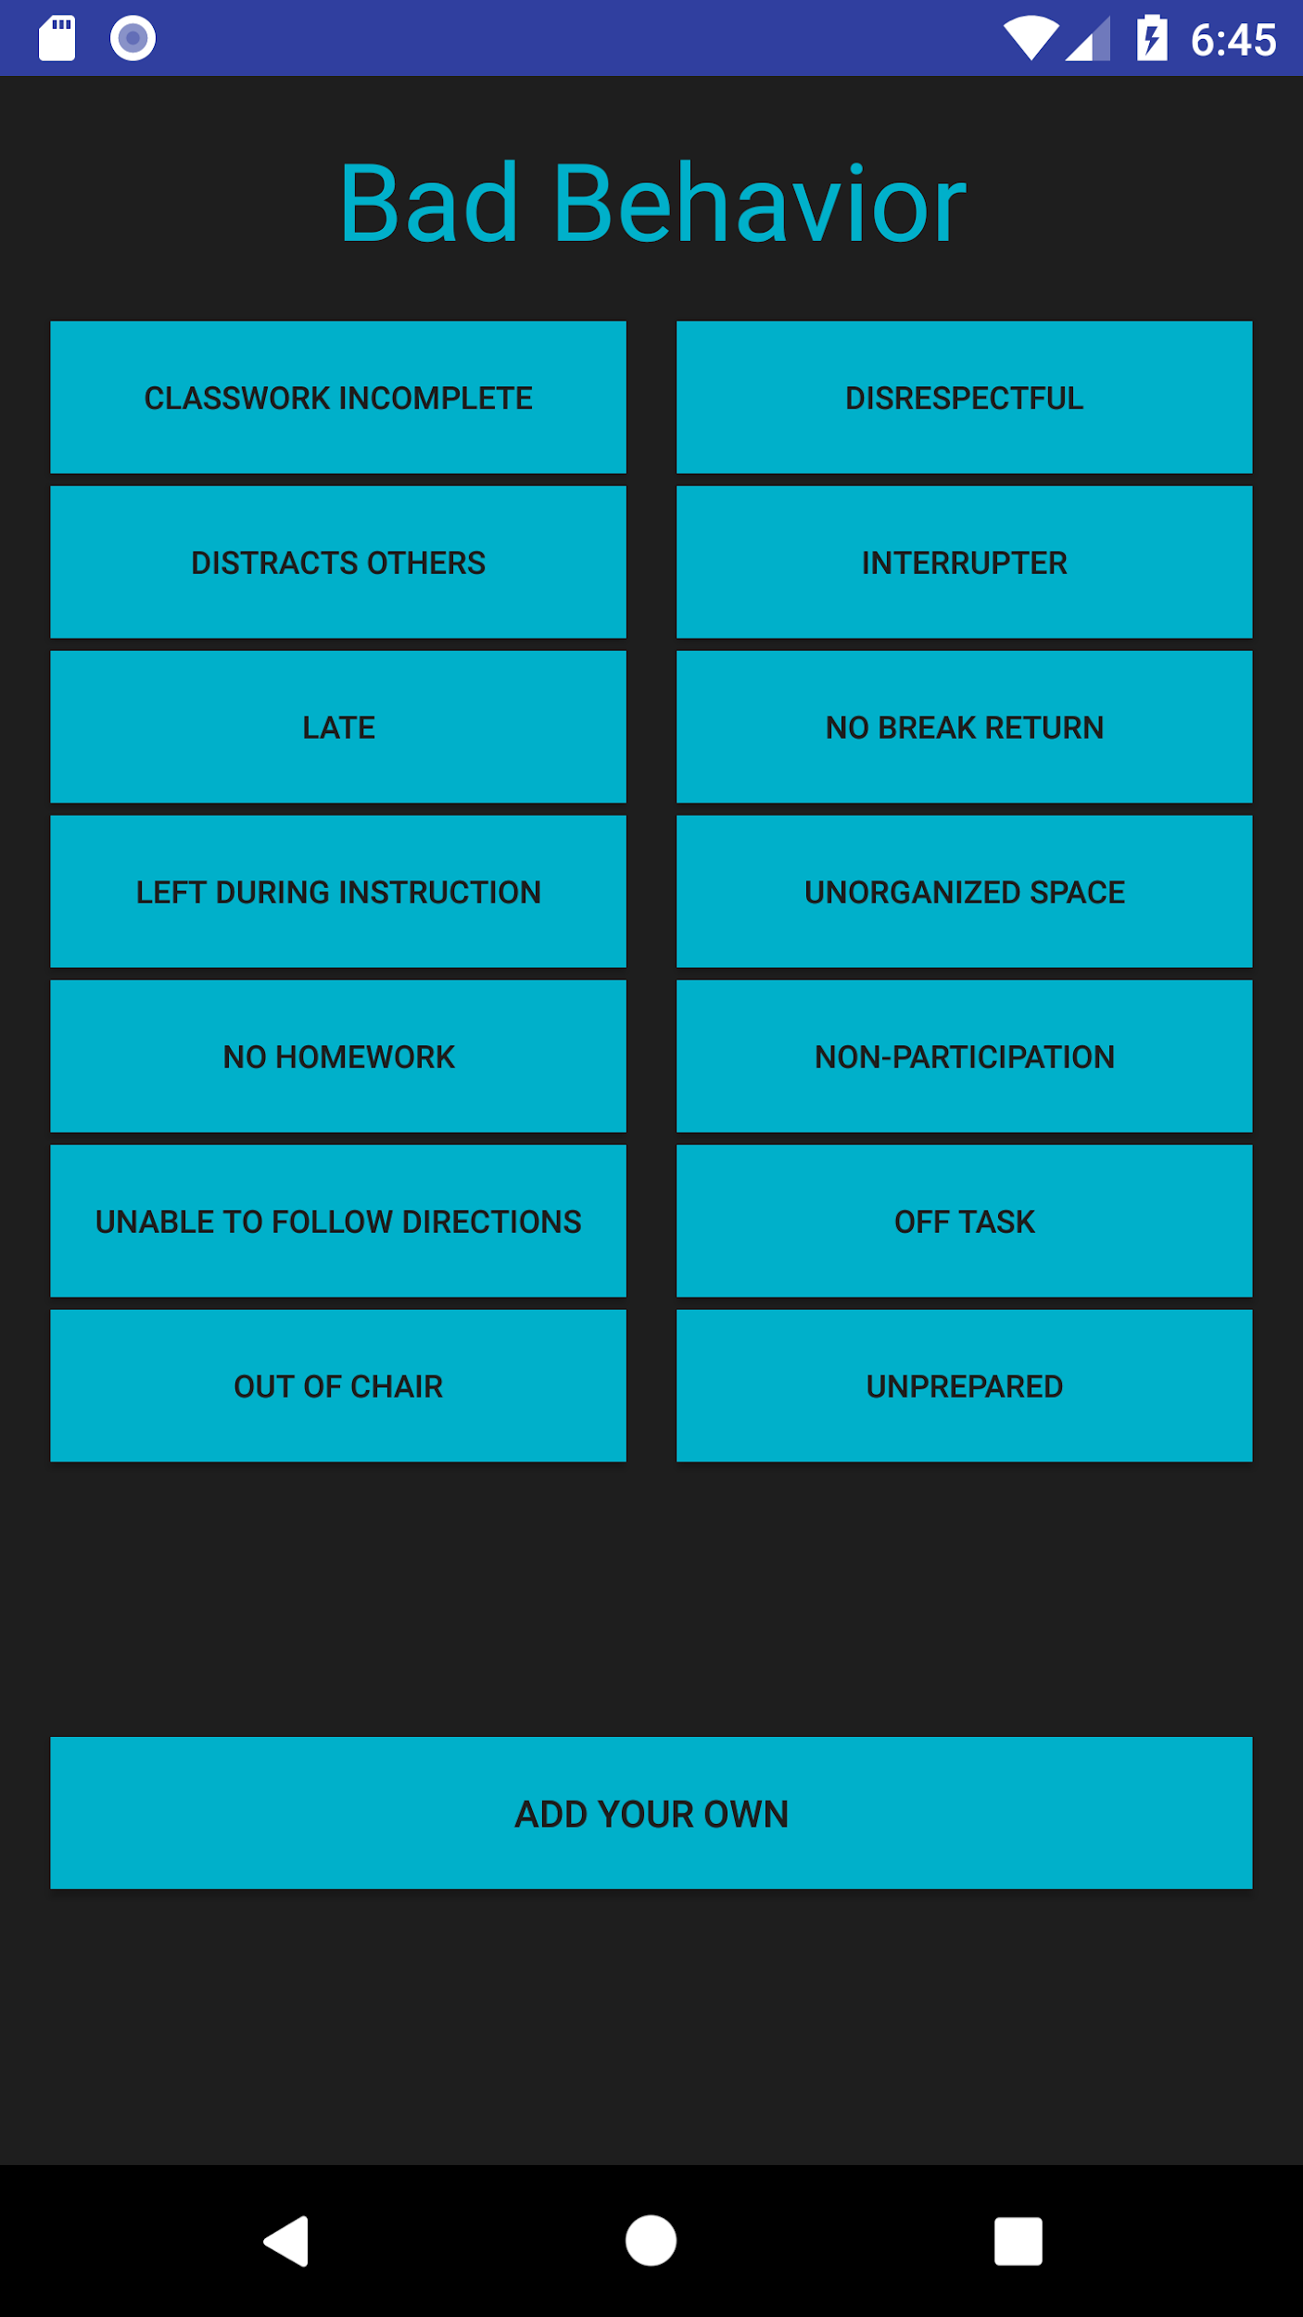
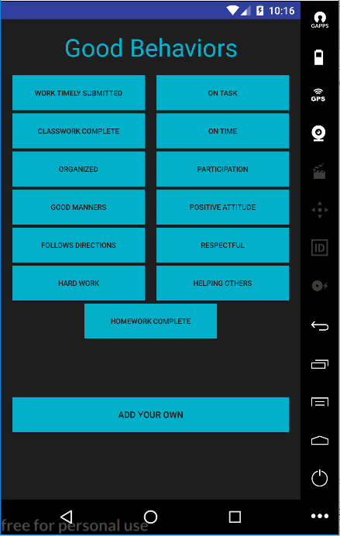
Add Behaviors

Slide 9
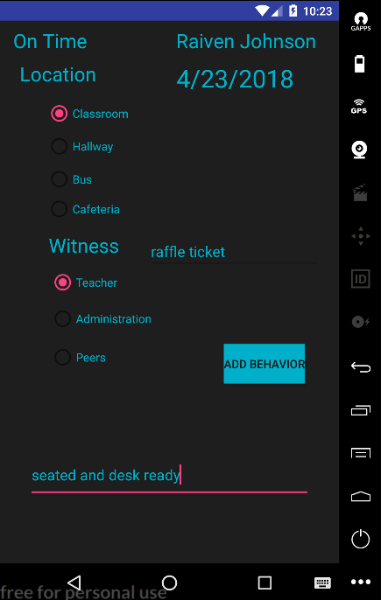
Behavior Tracking

Slide 10
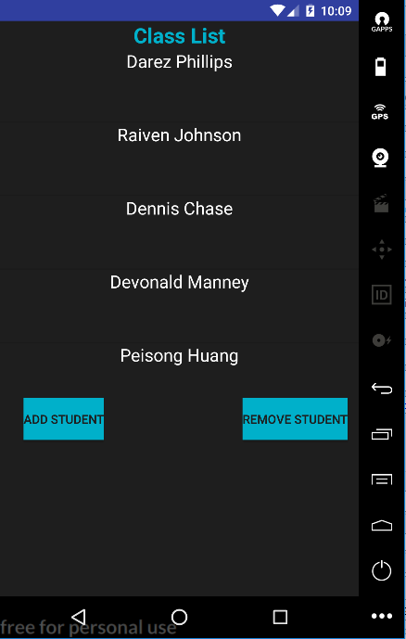
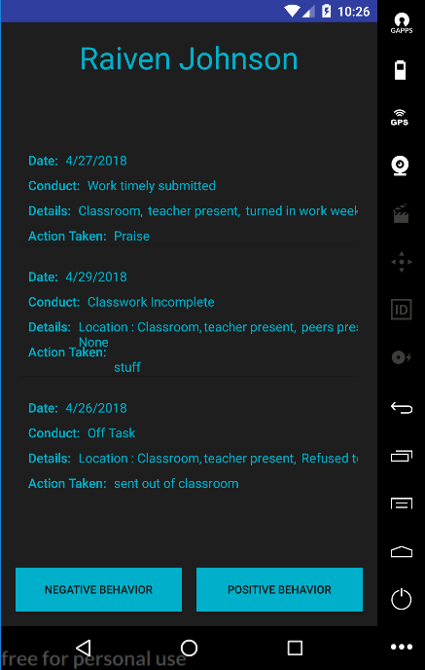
Student Overview

Slide 11
Thank You

